Slide 1
Cloud Computing
-Bhargav teja (22071A67B7)

Slide 2
Introduction to Cloud Computing
Definition - Cloud Computing means storing and accessing the data and programs on remote servers that are hosted on the internet instead of the computer’s hard drive or local server.
Key Concept: Instead of owning computing infrastructure or data centers, businesses can rent access to anything from applications to storage from a cloud service provider.

Slide 3
Key Characteristics
On-Demand Self-Service: Users can access resources automatically without human interaction.
Broad Network Access: Services are available over the internet and accessible through standard mechanisms.
Resource Pooling: Cloud providers pool resources to serve multiple customers using multi-tenant models.
Rapid Elasticity: Resources can scale out or in rapidly, depending on demand.
Measured Service: Cloud systems automatically control and optimize resource use through metering capabilities.

Slide 4
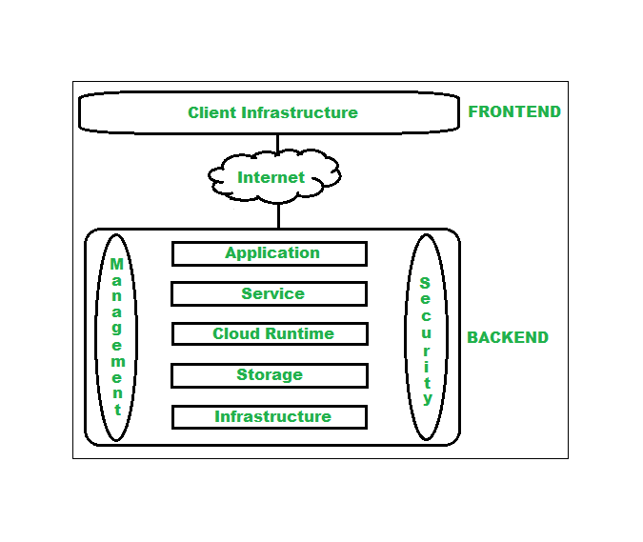
Cloud Computing Architecture
1. Frontend
Frontend of the cloud architecture refers to the client side of cloud computing system.
2. Backend
Backend refers to the cloud itself which is used by the service provider.

Slide 5
Deployment models in Cloud Computing
Public Cloud:
Services delivered over the public internet, shared by multiple users.
Example: Amazon Web Services, Microsoft Azure.
Private Cloud:
Exclusive cloud infrastructure used by a single organization.
Example: On-premise cloud solutions built using VMware.
Hybrid Cloud:
A mix of public and private clouds that work together, allowing data and applications to be shared between them.
Example: Combining AWS with an on-premise data center.

Slide 6
Benefits of Cloud Computing
Makes overall cloud computing system simpler.
Improves data processing requirements.
Helps in providing high security.
Makes it more modularized.
Results in better disaster recovery.
Gives good user accessibility.
Reduces IT operating costs.
Provides high level reliability.
Scalability.

Slide 7
Challenges of Cloud Computing
Security Risks: Potential data breaches and cyber attacks.
Downtime: Cloud services can experience outages or downtime.
Limited Control: Businesses may have limited control over infrastructure and services.
Vendor Lock-In: Difficulties in switching providers or migrating data.

Slide 8
Major Cloud Providers
Amazon Web Services (AWS): Largest cloud provider offering a wide range of services.
Microsoft Azure: Strong integration with Microsoft products, popular for enterprise solutions.
Google Cloud Platform (GCP): Focus on data analytics and machine learning.
IBM Cloud: Focus on AI, blockchain, and enterprise-level solutions.

Slide 9
Use cases of Cloud Computing
E-Commerce: Scalable online stores and platforms (e.g., Shopify).
Big Data & Analytics: Platforms for analyzing large datasets (e.g., Google BigQuery).
AI & Machine Learning: Cloud-based AI services like AWS SageMaker, Google AI.
Gaming: Cloud gaming platforms (e.g., Google Stadia, Xbox Cloud Gaming).
DevOps: Continuous integration and deployment tools hosted on the cloud (e.g., Jenkins on AWS).

Slide 10
Conclusion
Cloud computing has revolutionized how businesses operate, offering scalable, cost-effective, and flexible solutions.
As technology advances, the cloud will continue to evolve, integrating more with AI, IoT, and edge computing.

